Slide 1
《软件项目管理》 ——敏捷规模化案例教程
第5章 项目团队组建
Modified by L Guo; Copyright DJ Ning
Notes:
This module discusses the decisions and actions required to establish an agile team as quickly and efficiently as possible.
Time to complete: 3 hours
Exercises/activities:
Shared Vision
Initial User Stories
Initial Architecture Envisioning
Prioritizing the User Stories

Slide 2

本章内容
砖：如何组建软件开发团队（始自寒武纪）
5.1 敏捷项目团队的角色和职责
主要角色和职责
敏捷项目经理的角色转变
5.2 敏捷开发团队
敏捷项目团队的文化
完整团队
5.3 项目管理环境准备
5.4 传统团队组织
小结
思考
Notes:
2

Slide 3
项目管理过程一览图
项目启动
项目实施
项目收尾
项目管理过程
项目启动
干系人分析
迭代1～n
开发项建书
项目规划
评估结果
项目收尾
准备项目环境
规划迭代
管理迭代
复审会议
发布管理
组建项目团队
迭代规划会议
迭代执行
迭代监控
回顾会议
项目验收
先启
精化
构造
移交
项建书
已批准的项建书
架构文档
监控报告
安装包
客户需求
产品订单
迭代计划
新功能增量
培训资料
项目 计划
发布计划
更新的产品订单
更新的产品订单
运维手册
高层架构文档
风险和问题列表
风险和问题列表
风险和问题列表
功能增量或发布版
功能增量发布版
Copy Right @ DJ Ning
Notes:
3
开发项目建议书 ： 包括高层技术远景和架构分析、高层需求分析
项目计划 包含了发布计划
发布管理：包括实现安装包、用户培训、运维机制的建立等内容

Slide 4
本章目标
通过本章的学习，你可以：
清楚敏捷项目团队的主要角色
清楚命令控制式管理策略和自组织之间的区别
清楚用于组织敏捷团队的策略
清楚“完整团队”的意义
清楚如何组织敏捷的工作环境
了解传统团队组织方法

Slide 5
Q：如果你是项目经理，如何对待下面的问题？
你会挑谁做你的队友？ （或者说具有什么技能的人？）
你认为团队中应当包括什么角色才是合理的？ （或者说职能如何分工？）
你看中了一位抢手的队员，你会如何说服他（她）？
案例

Slide 6
本章内容
砖：如何组建软件开发团队（始自寒武纪）
5.1 敏捷项目团队的角色和职责
主要角色和职责
敏捷项目经理的角色转变
5.2 敏捷开发团队
敏捷项目团队的文化
完整团队
5.3 项目管理环境准备
5.4 传统团队组织
小结
思考
Notes:
6

Slide 7
砖：企业的用人之道——《软件工程与项目管理解析》
1. 如何组建软件开发团队
1) 组建团队的基本流程（四个步骤）
首先要了解产品的开发需求
其次要确定项目的人员需求
然后物色符合需求的人才
最终建立团队

Slide 8
团队的人员应当首先在企业内部挑选，最大程度利用现有人力资源。
人员结构应当是金字塔形。
团队领导
10%
核心成员
30%
普通成员
60%

Slide 9
2) 人才的选择
“黑猫白猫论” 案例
团队一定要有优秀人才
团队优秀人才不要太多，够用就行
成本过高
“一山难容二虎”

Slide 10
3) 确定团队的领导者
应具备四项素质：
不错的技术才能
较强的管理能力
丰富的产品开发经验
敏锐的商业头脑
问题：对于项目经理，技术能力和管理能力哪项重要？
视项目规模决定
大项目：侧重管理
小项目：侧重技术
通常强调平均能力与突出的人际关系处理（沟通）能力

Slide 11
4) 确定团队的核心成员
可以为领导者减轻负担。
核心成员应具备的素质：
才能
责任心
忠诚度

Slide 12
5) 确定团队的普通成员
普通成员应具备的素质：
技能合格
安分守己——“帕金森定律”
任劳任怨
无论确定哪一层次的人员，都不要苛求完美，要充分利用现有条件的人员。
Notes:
帕金森定律（Parkinson'sLaw）是官僚主义或官僚主义现象的一种别称，被称为二十世纪西方文化三大发现之一。也可称之为“官场病”、“组织麻痹病”或者“大企业病”，源于英国著名历史学家诺斯古德·帕金森1958年出版的《帕金森定律》一书的标题。
“在行政管理中，行政机构会像金字塔一样不断增多，行政人员会不断膨胀，每个人都很忙，但组织效率越来越低下。”
阐述了机构人员膨胀的原因及后果：一个不称职的官员，可能有三条出路，第一是申请退职，把位子让给能干的人；第二是让一位能干的人来协助自己工作；第三是任用两个水平比自己更低的人当助手。这第一条路是万万走不得的，因为那样会丧失许多权利；第二条路也不能走，因为那个能干的人会成为自己的对手；看来只有第三条路最适宜。

Slide 13
2. 如何管理软件开发团队
主要是垂直管理
基本目标：让所有成员有条不紊地开展工作，保证效率。
努力目标：调动一切积极因素，提高效率。
策略：规范化的过程管理。

Slide 14
本章内容
砖：如何组建软件开发团队（始自寒武纪）
5.1 敏捷项目团队的角色和职责
主要角色和职责
敏捷项目经理的角色转变
5.2 敏捷开发团队
敏捷项目团队的文化
完整团队
5.3 项目管理环境准备
5.4 传统团队组织
小结
思考
Notes:
14

Slide 15
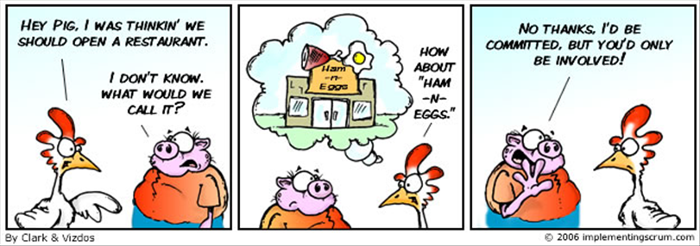
Scrum团队中的“猪”和“鸡”

Slide 16



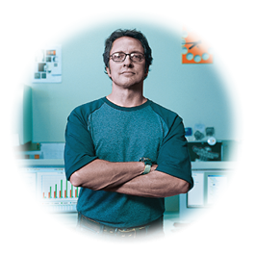


在有纪律的敏捷团队中的角色
主要角色:
涉众（Stakeholder）
产品负责人（Product Owner）
团队负责人（Team Lead)
团队成员（Agile Team Member）
架构负责人（Architecture Owner）
附加角色:
领域专家（Domain Expert）
技术专家（Technical Expert）
独立测试人员（Independent Tester）
集成人员（Integrator）
专业人员（Specialist）
Notes:
Agile roles are different than traditional roles, even though they may sound similar to what you are used to.
Many organizations struggle to adopt agile effectively because they’re not willing to make the changes necessary to support these new roles. This is an example of the “Organizational Complexity” scaling factor.
Agile principle # 5: Build projects around motivated individuals. Give them the environment and support they need, and trust them to get the job done.
High-light roles from customer domain and discuss how role participates
Stakeholder
Product Owner
Team Lead

Slide 17
涉众
涉众是指可以影响项目的执行或完成情况，同时也受其影响的人
IBM Outside In Development (OID)定义四类涉众：
终端用户－系统直接或间接的使用者
内部人员 － 用户的管理者, 程序/产品系列的管理者, 其他系统的开发人员（该系统与正在开发的系统有集成或者交互）, 潜在地受当前系统的开发以及部署影响的维护专家，审计员, …
出资人/主要负责人－ 高级经理，项目投资人，…
参与者 －操作职员和支持人员（服务台)
Notes:
Outside In Development (OID) is a methodology developed within IBM Software Group (SWG). It is described in the book Outside In Software Development by Karl Kessler and John Sweitzer.
Agile principle # 4: Business people and developers must work together daily throughout the project.

Slide 18








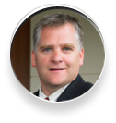


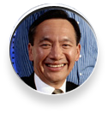
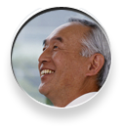

产品负责人
定义并提升产品的愿景和目标，以便整个团队可以作出决策
负责产品的订单/工作任务列表，制定优先级，并且为工作任务定义验收条件
定义产品发布的范围/内容（发布计划）
定义产品发布验收条件，并决定系统何时可以发布
现有的业务分析人员通常会演变成这个角色
团队成员
终端用户
外部系统组
领域专家
团队领导
产品负责人
审计员
团队成员
团队成员
高级经理
投资人
操作人员
支持人员
Notes:
The Product Owner:
Is typically onsite and collocated with the core project team throughout the project.
Is really a communication conduit between the team and stakeholders.
Must have agile business analysis and project management/planning skills.
Gets the team access to the relevant stakeholders just in time.
Monitors the project burndown.
Diagram used with permission http://www.agilemodeling.com/essays/agileAnalysis.htm

Slide 19
团队负责人
对项目成功负责，对开发流程负责
也称为Team Coach or Scrum Master
在项目的初始阶段
建立团队
推动产品backlog的创建和演化
推动发布计划的创建和演进
推动迭代计划
每天
组织每日站立会议
清除障碍
度量进度
引导团队
计划和组织迭代评审
Notes:
The Team Lead:
Facilitates close cooperation across all roles and functions.
Ensures that the team is fully functional and productive.
Keeps team focused in context of vision and goals.
Removes barriers and issues.
Protects the team from interruptions and external interferences.
Maintains open honest communication:
With product owner or business sponsor
Between team members
Ensures that process is followed (daily meetings, iteration planning and review, and so forth).
Ensures that value add agile practices and principles are used within the team.
Coaches others in the use and application of agile practices.
Prompts the team to think through problems.
Facilitates decision making (does not make decisions or mandate internal team activity).
Assists with record keeping for Burndown and other artifacts

Slide 20
敏捷团队成员
包括了在团队中的其他所有成员
通常称为“开发人员”
跨职能的，协作的，自管理的
必须参加每日的站立会议
为产品backlog中的工作项提供“相对大小”的估计
积极的参与迭代计划
维护迭代backlog和taskboard
每日更新“未完成工作”的估计
An agile team member can do everything within the boundaries of the project guidelines and established standards to reach the iteration goal.
He or she may need to call on others for help
Notes:
An agile team member can do everything within the boundaries of the project guidelines and established standards to reach the iteration goal.
He or she may need to call on others for help

Slide 21
架构负责人
负责当前团队正在构建的系统或者子系统的架构
面对架构问题时给开发人员以指导培训，并引导他们攻克技术难点
理解组织的架构方向和标准，并帮助确保整个团队与此一致
不仅仅负责架构，而是团队的技术领导
面对技术决策时具有最终发言权，但要尽力避免以独断专行的方式决定架构方向，而是应采用协作的，以团队为基础的方法
Notes:
This role is responsible for facilitating architectural decisions on a sub-team and is part of the architecture owner team, which is responsible for the overall architectural direction of the project. The architecture owner leads their sub-team through initial architecture envisioning for their sub-systems and is involved with the initial architecture envisioning for the system as a whole. Architecture Owners are different from traditional architects in that they are not solely responsible for setting the architectural direction, but also facilitate its creation and evolution.
See also www.agilemodeling.com/essays/architectureOwner.htm
This is an improvement over core agile, which minimizes the importance of the architecture role. In DAD, which takes a risk-value approach to the lifecycle, they have some responsibility (along with other team members) to convince the Product Owner to prioritize work items related to technical risk.

Slide 22
附加的敏捷角色
领域专家
具有问题领域一个或多个方面的深入知识
技术专家
具有解决问题所必须的深入技术知识
独立测试人员
关注于复杂的测试工作，和敏捷团队并行工作但独立于敏捷团队
集成人员
负责基于不同的子系统构建整个系统
其他专业人员
有时候某些团队需要某个特定领域的技术人员
Notes:
Domain Expert: The product owner represents a wide range of stakeholders, not just end users, so it isn't reasonable to expect them to be experts in every nuance in your domain. The product owner will sometimes bring in domain experts to work with the team, for example, a tax expert to explain the details of a requirement or the sponsoring executive to explain the vision for the project.
Technical Expert: Sometimes the team needs the help of technical experts, such as build masters, to set up their build scripts or an agile database administrator to help design and test their database. Technical experts are brought in on as needed, on a temporary basis, to help the team overcome a difficult problem and to transfer their skills to one or more developers on the team
Independent Tester: Effective agile teams often have an independent test team working in parallel that validates their work throughout the lifecycle. Typically needed for scaling issues (complex domains, complex technology, regulatory compliance)
Integrator: The subteams are typically responsible for one or more subsystems. The larger the overall team, generally the larger and more complicated the system being built. In these situations, the overall team may require one or more people in the role of integrator. The integrator is responsible for building the entire system from its various subsystems. Integrators often work closely with the independent test team, if there is one, to perform system integration testing regularly throughout the project. Typically needed only for complex systems.
Specialist. Sometimes component subteams require people focused on narrow specialties. For example, a team working on a security component likely requires one or more security specialists.

Slide 23
本章内容
砖：如何组建软件开发团队（始自寒武纪）
5.1 敏捷项目团队的角色和职责
主要角色和职责
敏捷项目经理的角色转变
5.2 敏捷开发团队
敏捷项目团队的文化
完整团队
5.3 项目管理环境准备
5.4 传统团队组织
小结
思考
Notes:
23

Slide 24

敏捷项目中项目管理角色的转变
引入敏捷技术后，人们会经常问到以下问题：
敏捷项目中强调自管理和共同协作，是否还需要项目经理？
PMBOK逐层逐条定义了一套固定框架，敏捷方法和PMBOK是否冲突？

Slide 25

答:
关键的项目管理活动是必需的，项目经理必须通过学习敏捷方法适应管理方式的改变
敏捷项目经理必须了解：
敏捷项目需要更多的灵活性，但仍要遵循“Process”
项目管理方法必须重新定制以适应敏捷
项目管理活动必须：
一定不要影响预期的目标
能被团队更好的分享和分担
项目经理仍然对整个项目负责，可信任可依赖
Notes:
Key project management activities are still necessary
Project management might be more important than ever
Project management practices must not interfere with the benefits that can be realized in Agile projects
PM activity may be shared differently
The PM is still responsible and accountable
WWPMM fully supports Agile

Slide 26
详细解释
敏捷项目中，项目经理的根本职责并未改变：
领导项目团队
对项目成功负责
基于协议和合同，发起、规划、执行、监控和收尾项目
执行正式的专业管理流程、方法、工具和技术，以有效管理范围、成本、风险、变更、问题、资源、协议和客户满意度
按时、保质且在预算内交付项目，实现更好的客户满意度
Notes:
What project managers are ultimately responsible for does not actually change in Agile development projects. In all projects, regardless of the development approach or technical methods used, project manager responsibilities include:
Leading the IBM project
Being accountable for the success of the IBM project
Initializing, planning, executing, monitoring, controlling, and closing projects according to established agreements and contracts
Utilizing formal profession processes, methods, tools, and techniques to manage scope, financials, risk, change, issues, resources, agreements, and customer satisfaction
Delivering the project on time, within budget, and with high customer satisfaction

Slide 27
但是，做事情的方法改变了……
项目经理需要发展领导力、沟通和团队管理能力，以期打造和谐的团队氛围
敏捷项目经理必须
更关注团队态度，而不是业务流程
更关注团队氛围，而不是管理方法
充当敏捷方法和公司原有业务规范的桥梁
Notes:
Project managers who are new to Agile must begin to learn how to do things differently
By definition, an Agile environment requires flexibility. However, this does not preclude more formal practices.
Project management methods should be tailored to be more flexible and performed iteratively on an Agile project
PMs need to develop behaviors for leadership, communication, and teaming that are consistent with this more flexible environment
On an Agile project, more value is placed on attitude than on process, and on environment more than on methodology. A project manager must balance the requirements of the traditional project management system with Agile views and concepts.

Slide 28
如何成为智慧的项目经理→智慧的敏捷项目经理
太上，不知有之；其次，亲而誉之；其次，畏之；其次，侮之。信不足焉，有不信焉。悠兮，其贵言。功成事遂，百姓皆谓我自然 — 老子
Lead
Manage
1）智慧的项目经理必须改变其管理风格和行为，更关注敏捷核心价值：
响应变更
客户交互和协作
开发可工作的产品或原型
干系人参与
Do
Notes:
Characteristics of Good Team Lead
Attitude:
putting team performance first and recognizing help is needed
Behavior:
Clarify purpose and goals, build commitment and self-confidence
Striking right balance between providing guidance and giving up control, making all the decisions
Striking balance between action and patience, strengthen the mix and level of skills, remove obstacles, do real work
Effectiveness:
Remove barriers to team performance
Encourage team individuals
Team Lead & Team Leadership are different concept.
Team leaders need to grow after they are selected.

Slide 29
2）管理方法敏捷化
管理风格更强调Coaching和Leading
教练(Coaching)：关注团队绩效，及时发现并提供所需帮助
领导(Leading)团队：不要命令和指导(Directing)，关注如何提高团队的投入程度（Commitment)
管理方法更关注团队氛围：强调自组织、自指导、参与和尊重
团队成员：更强调激励，关注态度
决策：由最接近问题的人进行决策，基于团队决策
任务分配：是拉，而不是被动地推的模式
Notes:
Iterations in OpenUP keep the team focused on delivering incremental customer value every few weeks by delivering a fully tested demo-able or shippable build (product increment).
Iteration planning, estimation, and progress tracking are centered on work items. The iteration plan is created by selecting the top-priority work items. Agile estimation techniques are used to understand how many work items can safely fit within the time-boxed iteration, and work items are filtered to ensure that the chosen work items will allow the team to deliver upon iteration objectives agreed to by stakeholders. Progress is demonstrated through continuous completion of many small work items (see Micro-Increments).
Self-organization – focus on pull rather than push approach – trust the team to get the job done
Team members work more effectively if they can influence what they do and how they do it, rather than operating in an environment where they are told what to do. Giving the team the ability and responsibility to organize their work and determine how to best meet their commitments motivates team members to do their best. This also helps them collaborate to ensure that the right skills are applied to the appropriate tasks. Self organization impacts many areas, including how planning and commitments are made (by a team, not by individuals), how work is assigned (you sign up versus get assigned), and how team members view their role in the project (team member first, job function second).

Slide 30
3）执行过程敏捷化
有效的做到：
及时消除影响团队绩效的任何障碍
有效平衡
命令指导 vs 放弃控制；
自己决策 vs 别人决策；
自己工作 vs 教会别人工作
合理分配领导、管理和实际工作的比例
Lead
Manage
Do
Notes:
Characteristics of Good Team Lead
Attitude:
putting team performance first and recognizing help is needed
Behavior:
Clarify purpose and goals, build commitment and self-confidence
Striking right balance between providing guidance and giving up control, making all the decisions
Striking balance between action and patience, strengthen the mix and level of skills, remove obstacles, do real work
Effectiveness:
Remove barriers to team performance
Encourage team individuals
Team Lead & Team Leadership are different concept.
Team leaders need to grow after they are selected.

Slide 31
本章内容
砖：如何组建软件开发团队（始自寒武纪）
5.1 敏捷项目团队的角色和职责
主要角色和职责
敏捷项目经理的角色转变
5.2 敏捷开发团队
敏捷项目团队的文化
完整团队
5.3 项目管理环境准备
5.4 传统团队组织
小结
思考
Notes:
31

Slide 32
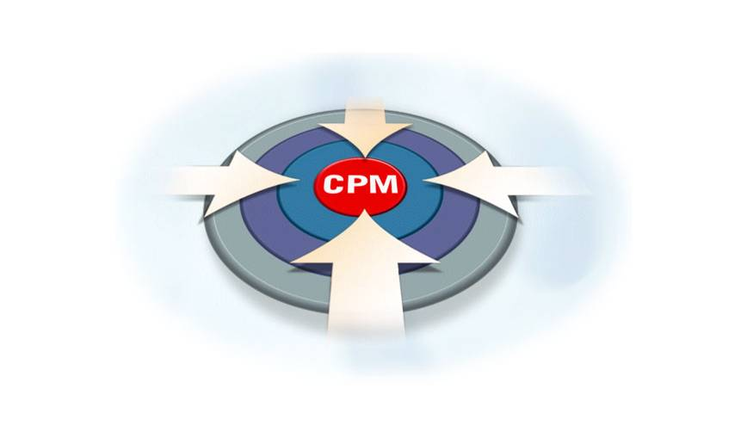

团队基本要素
技能互补
承诺使用统一方法
小团队
承诺为共同的目标而奋斗
互相依赖、相互负责
Notes:
32
To summarize these thoughts, when you start looking at your customer/prospect lists, know that we have many entry points into companies. CFO, Executives, IT, or LOB.
Each has a particular performance challenge that leads back to the tactical pains preventing people from harnessing their information for business optimization.
We have the opportunity position and sell to our targets around a business intelligence (BI) pure Play, a Financial Performance Management (FPM) pure Play or around a specific industry solution area relevant to the specific industry
Now lets take a closer look at the IBM Cognos positioning around BI, FPM and our specific industry solutions.

Slide 33
如何成为智慧的团队
很多软件项目团队超过20个人
经常组织成需求、架构、开发和测试等竖井式的团队
It is unSmart
需求
实施
测试
多技能、跨职能团队
典型的团队大小少于10人
Scrum团队一般有4～8个人
It is Smart
软件团队就像是一个体育团队，它需要各种能力有效组合去赢
Notes:
<Master Title>
© 2007 Ivar Jacobson International

Slide 34
→智慧的敏捷团队采用的策略
保持有效的策略:
具有完成工作的全部技能 – 即是“完整的”
尽可能小
成员专职在项目中
单独的产品负责人
单独的团队负责人（不能是产品负责人）
跨职能，由“通才”组成
可能会包含期望成为“通才”的专家
自组织（在一个适当的管理框架内）
越偏离这些策略，你的项目就越危险

Slide 35
本章内容
砖：如何组建软件开发团队（始自寒武纪）
5.1 敏捷项目团队的角色和职责
主要角色和职责
敏捷项目经理的角色转变
5.2 敏捷开发团队
敏捷项目团队的文化
完整团队
5.3 项目管理环境准备
5.4 传统团队组织
小结
思考
Notes:
35

Slide 36
1. 什么是完整团队(Whole Team)
是一种开发哲学或者风格：在团队成员和涉众之间引入协作
团队中包括所有与开发并交付软件相关的成员
任何对项目有贡献的人
直接或者间接的参与者，例如投资人或者涉众
所有成员能有效沟通问题本质，并达成共识
完整团队(whole team)具有以下特征:
自组织的
跨职能的
紧密协作的
Notes:
Self-organizing teams have the authority to choose the work to be performed, and the responsibility to do that work in the best way.
Cross-functional teams have less narrowly focused specialists and more “generalizing specialists” (or multi-disciplinary developers).
Highly collaborative teams work together closely to achieve the objectives of the project: they share the responsibility of making that happening (accountability, no throwing documents over the wall, and so on).
Agile principle # 4: Business people and developers must work together daily throughout the project.
Agile principle # 5: Build projects around motivated individuals. Give them the environment and support they need, and trust them to get the job done.
The Whole Team expands on the practices of self-organizing teams and cross function teams.
Whole Teams are highly collaborative; the team works closely to achieve the objectives of the project regardless of team member location.

Slide 37



2. 传统的团队协作 vs 完整团队
传统团队
通常包含特定专业领域的技术专家
这往往会导致低效，因为需要更多的管理代价，更长的工作等待，和更多的文档
项目经理
业务分析师
软件架构师
测试人员
涉众
开发人员
Notes:
Recommended Reading: http://www.agilemodeling.com/essays/generalizingSpecialists.htm

Slide 38
完整团队
具有跨职能团队成员，所以能够去承担多个角色
更少的成员，所以管理代价更低
良好的沟通和协作，能促进技能和知识的学习
项目风险被降低
涉众
产品负责人
团队成员
团队负责人
团队成员
团队成员
Notes:
.
For example, if test cases need to be executed, any member of the team could “sign up” or “pull” that work activity in Whole Teams: On a traditional team, there may be a resource constraint if the Tester is busy with other things.
Advantages of the whole team approach:
Improved communication and collaboration.
Less documentation
Improved flexibility
Less risk

Slide 39
3. 完整团队中的成员——每一个人的权利
被尊重的对待(To be treated with respect)
基于项目共识，任何时候都能接收工作，保质保量
能够对个人工作估计耗时，同时这些估计能够被其他人所尊重
能够获得足够的资源（时间，资金等）开展工作
能够决定资源的使用方式
拥有学习的机会，业务人员往往希望学习技术，而技术人员则可能更需要学习业务知识
能够适时的作出决策
能够适时的获得有用的，正确的信息。尽管有时候这些信息只是目前最好的。例如需求排序表，详细的领域概念，详细的设计等
拥有标准软件流程，遵循流程并在需要的时候积极改进这些流程

Slide 40
——每一个人的职责
在你选择的资源环境下，构建满足需求的系统
乐于和其他人共事，特别是那些“不速之客”
例如你期待之外的专家
乐于分享所有的信息，包括“工作进度”等
积极的扩展你的知识和技能

Slide 41

4. 完整团队的特点——1） 敏捷化的
敏捷核心
迭代开发
两级项目规划
完整团队
持续集成
测试驱动开发
More Smart Real Team
Scrum团队一般有4～8个人
拥有多种技能的、跨职能协作的团队
关注向干系人交付价值
自指导、自组织、可持续的速度
Notes:
Bottom line – we all work together… everyone contributes in some way some piece
However, not run off on your own… needs to be done in “tune” with what is needed…
Not go off and develop whatever you want and share it… then tell everyone there is nothing wrong with YOUR code its gotta be user error if you will. Abdicating responsibility isn’t allowed in the whole team approach… no “YOUR UGLY BABY” … its all “OUR”

Slide 42

——2） 自指导
共享远景和目标
团队承诺
拥有共同目标、分担责任，彼此承诺致力于目标实现
团队拥有足够的授权和资源，解决问题，找到自己的成功之路
做自己喜欢的事情
有效的沟通和信息的透明
适当的团队建设
Notes:
M团队成员绩效：
拥有多种技能的、跨职能协作的团队
做自己喜欢的事情
有效的沟通和信息的透明
适当的团队建设
anagers expect that self directed people will spend time sitting in the park not doing real work.
We have to trust our teams to deliver every two weeks. Frequent status meetings are a waste of time.
It can be difficult at times to convince our managers of this to use self-directed teams.

Slide 43

——3） 自组织
Self-Organized
团队要选择自己的工作 ：做团队擅长或应该做的工作
每个人选择自己的工作：做自己喜欢的事情
团队决定如何完成工作：强调良好的团队氛围
每个人都承诺完成自己的工作 ：强调尊重
团队进行有规律的协调工作：坦诚、开放的沟通
Notes:
The team selects its own work. At the beginning of a work cycle, the team collectively selects the work from the prioritized [Project Work]. Work selection is performed within given constraints, including the priorities set by stakeholders, time (such as the length of the current work cycle, iteration or project increment), the budget, and the skills of team members.
Individuals select their own work. Someone will choose to do something because they are good at it and know that they can do the work effectively, because they want to gain more experience at something and hope to improve their skills by working with someone with such experience, or because they know that the work needs to be done and that it's their turn to do so. Although an individual fulfills one or more roles on a project team, that doesn't imply that the person is constrained to doing only specific types of work.
The team determines how to perform the work. At the beginning of a work cycle, the team holds an "all hands" planning meeting where it determines the general strategy for doing the work and the tasks required for that. More detailed planning, if required, will be done on a just-in-time basis by the individuals doing the work. Notice that the team is still constrained by your organization's standards, technical infrastructure, regulations, and so on.
Everyone commits to the work. The team commits to accomplishing the work that it has agreed to do by the end of the work cycle. Individuals also commit to doing the work that they say they will do in that cycle, although as the time progresses, various tasks may be renegotiated as required.
The team coordinates regularly. To ensure that the work is accomplished, the team must coordinate its efforts effectively. This is typically done through daily standup (scrum) meetings of the team and impromptu discussions between individuals.
团队成员绩效：
做自己喜欢的事情
有效的沟通和信息的透明
适当的团队建设
anagers expect that self directed people will spend time sitting in the park not doing real work.
We have to trust our teams to deliver every two weeks. Frequent status meetings are a waste of time.
It can be difficult at times to convince our managers of this to use self-directed teams.

Slide 44
补充：自组织的基本定义
谁负责做该项工作，那么最好也能够去组织这项工作
与命令式对比
命令控制式方法:
经理向团队成员分配任务
自组织方法:
团队成员计划并估计他自己的工作
并且往往会以团队的方式工作
Notes:
Characteristics of self organizing teams:
The team is responsible for managing the development activities not just the Team Lead or Project Manager.
Team members sign up for work and update artifacts to reflect who is responsible for what work in a given iteration.
Individuals aren’t assigned work instead they sign up or pull work from the product backlog or work-item list.
Decisions are made as a team.
Team members share a goal and a common belief that their work is interdependent and collaboration is the best way to accomplish their goal.
Members reduce their dependency on management as they accept accountability, and the team structure places ownership and control close to the core of the work.
Agile principle # 11: The best architectures, requirements, and designs emerge from self-organizing teams.
Whole Teams are self organized.
Self Organizing Teams are about:
Sharing a common goal, and collaborating to accomplish the goal
Being part of an empowered team

Slide 45
练习：命令和控制 vs 自组织
2个学员组成1个小组，尝试选择你不认识的一位学员
一位扮演“经理”；另一位扮演“开发人员”
在地面上围出一个区域
规则:
每一个人， 包括经理，在整个练习期间都必须站在这块区域内部
经理可以对开发人员发出三种命令：
向前迈一步，左转，右转
开发人员必须严格按照经理所说的执行
你们有两分钟的时间可以迈出50步
Notes:
Commands:
Take a step: The developer takes one step forward
Turn left: The developer turns their body 90 degrees to the left
Turn right: The developer turns their body 90 degrees to the right
Exercise: Part 1 showing how project managers make all the decisions for developers.
Students should pair up.
Everyone should stay within the taped area.
If someone steps outside of the taped area, fine them by having them take 10 more steps.

Slide 46
现在，每一个人都扮演“开发人员”的角色
规则:
在练习过程中每一个人都必须站在区域内部
开发人员可以做以下三个动作:
迈一步，左转，右转
你们有一分钟的时间可以迈出50步
结论： 自组织的效率远高于命令控制方式

Slide 47



——4） 开发过程稳定可持续
敏捷过程推行可持续的开发 – 保持团队在一个可持续的生产力水平上工作
Notes:
47
What is sustainable pace?
Anyone read the Death March books, “software engineering can be like being on a death march” keep walking until you drop dead and “nothing gets finished”
How many people may have been told “if you aren’t comfortable working 80 hours a week, you are in the wrong industry” but 80 hours a week isn’t a sustainable pace is it?

Slide 48

问：如何保证开发人员是忙碌且有效率的？
忙碌的开发人员是富有成效且忠心耿耿的，也是开发过程稳定可持续的保障
频繁的反馈
无干扰的工作进程
有效的激励
高效的协作

Slide 49
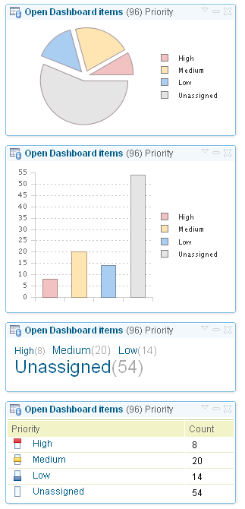
Accelerator：1）要在适当管理下开发
Lean开发管理
团队也不是要毫无约束地进行工作
自组织也必须受企业目标和环境的约束
自动化的度量和项目仪表盘
通过自动化可以使大部分Scrum需要的管理规范更加有效率
这是真实的经验总结，不只是广告宣传
Rational Team Concert (RTC) 项目仪表盘
Rational Insight组合管理仪表盘
采用团队的开发习惯
通过静态分析工具“强制执行”
Notes:
Some people see self-organization as teams being out of control.
Self-organizing teams must still work within the organizational environment.
They must be governed and monitored.
They should follow corporate conventions and work to your common infrastructure.
Reference: https://www14.software.ibm.com/webapp/iwm/web/preLogin.do?lang=en_US&source=swg-ldg

Slide 50

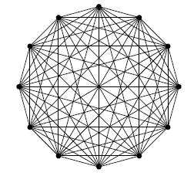

Accelerator ：2）小的，专注的项目团队
策略: 保持核心团队的大小为4到10人之间以达到高效
为什么要这么做？
覆盖了所有的角色
最大化团队活力，例如：提升创造性而不是从众思维; 建立紧密度，相互信任和尊重
降低沟通/交互的费用和开销
确保团队/项目的可管理性，同时提高了质量和生产率
团队大小: | 1 - 4 | 5 - 10 | 11+
平均关系数量: | 3 | 26 | 55+
估计的平均管理时间 ª: | 15 | 48 | 68+
生产率: | OK | Great | Poor
4 个人 5个人 12个人
6 个关系 10 个关系 66 个关系
ª Based on PMI estimate of 10% - 25% of total hours
Notes:
The project is staffed by a core dedicated team of 4 to 8 members to ensure simple manageability and close communication and collaboration, creating a Teaming environment.
And initiative can be decomposed into these numbers, based on the attributes of that project.
Reference: (see Stephen Robbins in Findings on High-Performance Teams and Katzenbach and Smith in Wisdom of Team – Creating the High Performance Organization)
Agile principle # 5: Build projects around motivated individuals. Give them the environment and support they need, and trust them to get the job done.
Keep teams between 5 – 10 people.
Fewer than 5 and the team may not be able to perform all roles.
More than 10 and the team will have too many communication channels and loose speed due to too much wasted interaction.
Example: Making decisions or schedule a meeting to discuss an issues becomes much more difficult as the number of team members increase.

Slide 51
尝试一个更小的核心团队 (1–4)
不能够覆盖所有的角色或者快速的完成大量的工作
尝试一个更大的核心团队 (11+)
由于不够紧密，缺乏信任和尊重，从而使团队失去活力
由于从众思维或者为了少数服从多数而丧失创造性
导致增加了沟通和交互费用和成本
团队和项目变得更不可控和分散而降低了质量和生产率
通常会导致团队被切分成另一个项目团队
核心团队 (如果选择离岸开发)
角色 | 现场 | 离岸
团队负责人/Scrum Master | 1
产品负责人 | 1
主要的开发人员 | 1 | 1
开发人员 | 2 – 4
测试专家 | 1

Slide 52
Accelerator ：3）跨职能的团队
更少的特定领域的专家
更多的“通才”
跨职能的开发人员，他们具有：
一个或更多领域的技术专长
软件或者系统开发的相关知识
业务领域的相关知识
… 并且积极的寻求获得新的技能
拥有跨职能团队的优点
改进了沟通和协作
更少的内部项目文档
提高了灵活性
更少的人为风险
Notes:
Reference: http://www.agilemodeling.com/essays/generalizingSpecialists.htm

Slide 53
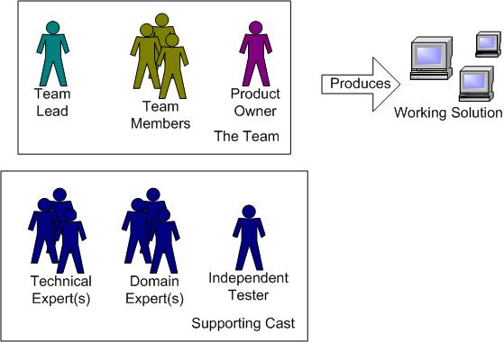
如何组织一个跨职能的小团队
最多只有15个人的团队
主要的团队角色:
团队负责人
团队成员
产品负责人
涉众(未展示)
支持角色:
技术专家 －按需引进，临时性的
领域专家 – 解释需求或者项目前景的细节
独立的测试人员
Notes:
Main Team Roles:
Team Coach. Responsible for facilitating the team, obtaining resources, and clearing roadblocks. Also called Project Lead, Team Lead, or Scrum Master.
Team members. Responsible for creating and delivering the system, which includes modeling, programming, testing, and release activities.
Stakeholder (not shown). Anyone who is a direct user, indirect user, manager of users, senior manager, operations staff member, the "gold owner" who funds the project, support staff member, auditors, your program or portfolio manager, developers working on other systems that integrate or interact with the one under development, or maintenance professionals who may be affected by the development or deployment of a software project.
Product Owner. Represents the stakeholders. Responsible for the prioritized work item list (called a product backlog in Scrum), for making decisions in a timely manner, and for providing information in a timely manner.
Describe the main team roles

Slide 54
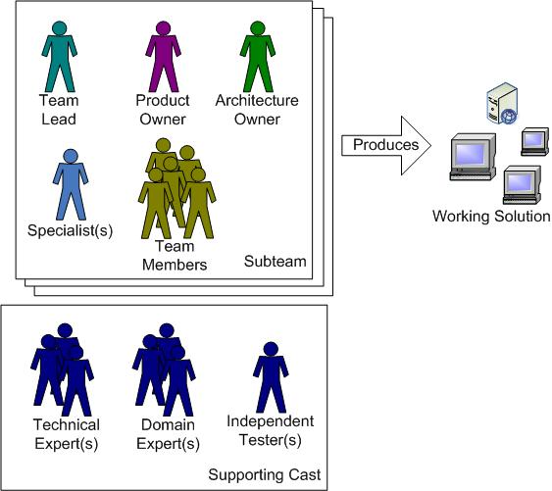
如何组织一个跨职能的中等团队
10到40个人的团队
实际上由小团队组成
新角色
团队架构负责人 – 负责在小团队上推动架构决策,
特定领域专家 – 通常对于短期或者复杂工作而设
Notes:
Coordination could occur via “scrum of scrums” -- someone from the subteam standup meeting attends an overall programme/project standup meeting
Specialists may be needed to spend a few days to set up a technology (e.g. a database, a development tool,…) and train the team in its use

Slide 55
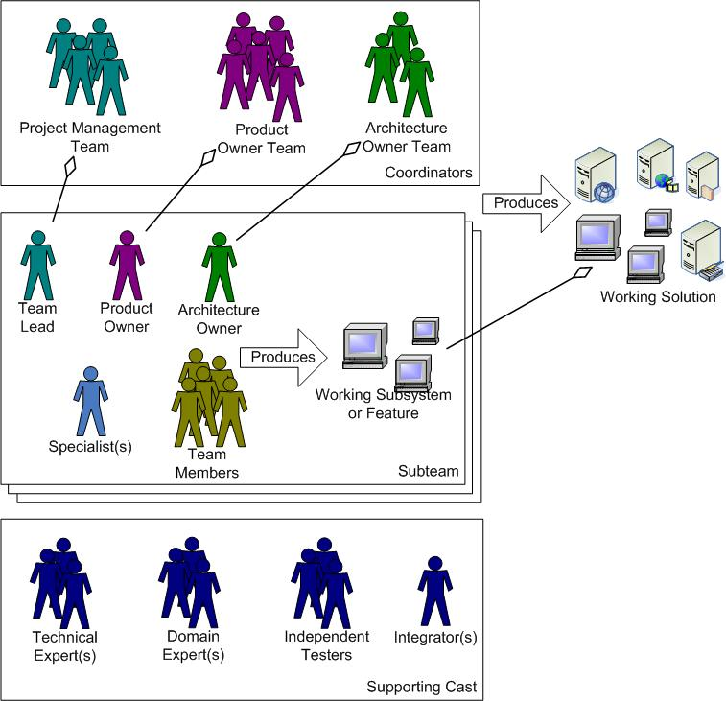
如何组织一个跨职能的大团队
30个人以上的团队
实际上是团队的团队
新角色
协调人员 － 随着团队变得更大，必须有一些成员负责协调项目管理，需求和技术问题
集成人员－负责基于不同的子系统建立整个系统
Notes:
Observations:
Most communication occurs between people working on subsystems or features.
Organizing around job functions increases risk, cost, and time to value.
Strategies for organizing larger teams:
Component-team approach: Organize the work around the architecture, not job roles, and then organize requirements around architecture (and vice versa)
Feature team approach – subteams work completely on features
Domain-driven architecture
Coordinate project management, requirements management, and technical issues
Re-introduce specialist roles as needed
Maximize the responsibilities of the offshore team (if applicable)
Provide guidance on enterprise infrastructure, development conventions

Slide 56
Accelerator ：4）保持专注，产生推动力
在整个项目周期中将所有的核心团队成员组织在同一个办公室中
敏捷房间:
设置大量的白板用于建模讨论和计划
用于张贴索引卡和其他纸张的黑板
公共的工作空间用于建模和计划
开放的办公环境用于提升交流，灵活性和可见性
为什么要这么做？
避免被打扰而分散精力，使团队成员更加关注在项目上
压缩沟通和交互时间到分钟级别
加速决策、问题解决和开发的时间
提高透明性和可理解性，减少意外状况的发生
培养团队精神，比如：创造性，协作性，集体所有，学习，主动性，信任，尊重， 达成目标
解决共同面对的障碍，例如：需求澄清、很高的变更频率
启用其它的关键机制，例如：业务和IT的一致，关注时间盒，原型
Notes:
Equipment that is essential to product delivery is dedicated to the use of the project team. This includes facilities and office and technical equipment.
Analogy on Importance: Think of a sports team. The Detroit Red Wings have hockey players from throughout the world, but they have to practice and skate together (on the same sheet of ice) and bond as a team through personal interaction. For high-end web development for business solutions, Cube space, multiple geographies, and different timezones constrain that. This is very challenged now, and there are variations that work.
The picture is an actual agile workroom from a Global Services agile project. Used with permission.
Other Considerations
Requires planning ahead
May simply take over a room
Use PC projector, digital camera, shared printer, whiteboards, flipcharts
Set room expectations
Consider individual’s circumstances
Have breakout rooms and access to private phones close to the team room
Virtual co-location via collaborative tools can add value, but is no substitution for physical co-location
Global Resources should also be co-located

Slide 57
实例：朗讯公司项目开发环境
图1
图2

Slide 58
本章内容
砖：如何组建软件开发团队（始自寒武纪）
5.1 敏捷项目团队的角色和职责
主要角色和职责
敏捷项目经理的角色转变
5.2 敏捷开发团队
敏捷项目团队的文化
完整团队
5.3 项目管理环境准备
5.4 传统团队组织
小结
思考
Notes:
58

Slide 59






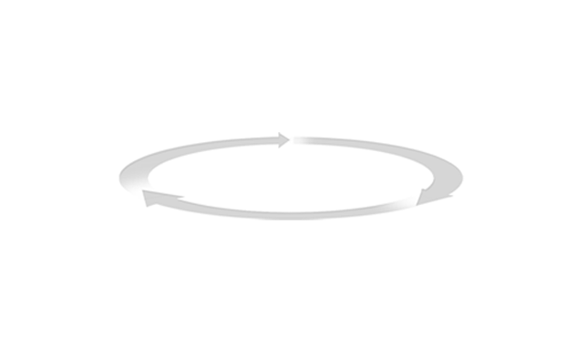
IBM RTC: 源自敏捷，服务敏捷
有效利用高效团队 的各项原则
IBM Rational Team Concert
支持各种过程， 包括敏捷过程的推行
工欲善其事、必先利其器
好的工具平台，能够有效的促进敏捷进程
It is Smart
transparent integrated presence wikis OPEN real-time reporting chat automated hand-offs Web 2.0 custom dashboards automated data gathering EXTENSIBILITY Eclipse plug-ins services architecture FREEDOM TO CREATE
可运行软件
个人和交互
快速响应变更
客户合作
持续集成
管理团队资产
变更驱动
整合的/可追踪的
始于团队的自然状态
感知团队
感知流程
自由分享
灵活的流程
迭代的计划和执行
多个发布
即时的代码复审
透明
共同的目标
项目健康状况
基于上下文的沟通
Notes:
59
May #s:
RTC Projects (Rational) 102 (291% increase)
RTC Projects (IGA) 167
RTC Projects Total 269 (Up from 35 in May 2008 – 760%)
RTC Users Rational 2205 (321% increase)
RTC Users IGA 3276
RTC Users Total 5481 (Up from 686 in May 2008 – 800% increase)

Slide 60
其他产品
VersionOne
Rally
ScrumWorks

Slide 61
本章内容
砖：如何组建软件开发团队（始自寒武纪）
5.1 敏捷项目团队的角色和职责
主要角色和职责
敏捷项目经理的角色转变
5.2 敏捷开发团队
敏捷项目团队的文化
完整团队
5.3 项目管理环境准备
5.4 传统团队组织
小结
思考
Notes:
61

Slide 62
角色和职责
角色：项目经理、系统分析员、系统设计员、数据库管理员、支持工程师、程序员、质量保证工程师、业务专家（用户）、测试人员等等。
1. 项目经理
对项目进行全面的管理
沟通者，团队领导者，决策者，气氛创造者等多个角色的综合
主要职责
开发计划
组织实施
项目控制

Slide 63
2. 需求分析师
客户与开发团队之间的桥梁
善于协调，良好的沟通技巧，具备业务和技术领域知识
主要职责
完成《软件需求规约》

Slide 64
3. 系统分析师
组中的“首席执行官”
主要职责
协助需求分析师进行需求调研
协助架构设计师进行架构设计
协助数据库设计师进行数据库逻辑设计和物理设计
协助软件设计师详细设计
指导软件工程师代码实现
协助项目经理进行配置管理，并提供优化改进建议
定期培训员工

Slide 65
4. 软件设计师
对分模块进行详细设计
主要职责
编写分模块的《系统详细说明书》；
负责对软件工程师讲解《系统详细设计说明书》内容；
协助软件工程师进行代码实现；
控制本模块的开发进度。

Slide 66
5. 软件工程师
主要职责
代码实现；
自我复查；
基础测试。
6. 测试工程师
主要职责
编写测试用例；
执行测试；
质量审计。

Slide 67
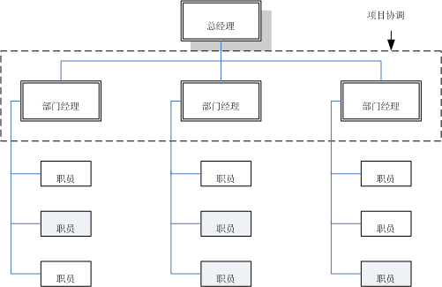
团队组织结构
职能型、项目型和矩阵型
1. 职能型组织结构

Slide 68
优点：
人力、知识等资源集中，继承了多个项目的经验；
一个专家可以同时服务多个项目；（并行）
便于部门内相互交流，相互支援；
可以随时增派人员；
缺点：
项目和部门利益易发生冲突，各部门更重视自己的利益；
资源平衡会出现问题；
权利分割不利于各个职能部门的交流和团结协作；
行政隶属关系使得项目经理没有充分的权利。

Slide 69
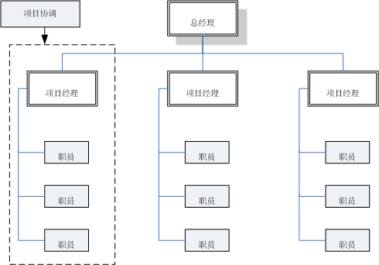
2. 项目型组织结构

Slide 70
优点：
项目经理对项目可以负全责；
项目目标单一，可以以项目为中心,有利于项目顺利进行；
避免多重领导；
组织结构简单，交流简单，快速。
缺点：
人力、文档等资源不能多项目共享；
各独立的项目处于相对封闭状态，不利于公司行政管理；
成员缺少事业上的连续性和安全感；
项目组织之间处于分割状态,缺少信息交流。

Slide 71
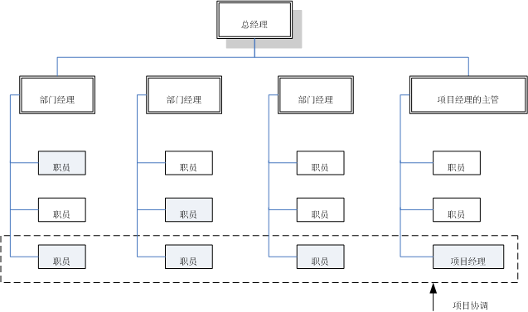
3. 矩阵型组织结构

Slide 72
优点：
专职的项目经理负责整个项目，以项目为中心，公司的多个项目可以共享各个职能部门的资源；
既有利于项目目标的实现，又有利于公司行政管理；
项目成员的顾虑减少了。
缺点：
容易引起职能经理和项目经理权力的冲突；
资源共享也能引起项目之间的冲突；
项目成员有多重领导。

Slide 73
角色职责矩阵
用来对项目团队成员进行分工，明确其角色与职责
矩阵中的符号表示项目工作人员在每个工作单元中的参与角色或责任：R表示直接责任；I表示参与。

Slide 74
小结
架构负责人不仅仅负责架构，而是技术领导
团队成员在敏捷团队中所扮演的角色和在传统团队中的是不同的；项目经理也要做出改变
敏捷团队是“完整团队”，是跨职能、协作、自管理的
利用每个团队成员的强项创造有价值的产品是非常重要的
公开和专注的工作区域能够对你团队的生产率产生积极的影响

Slide 75

思考
完整团队的特征？
敏捷团队几人为宜？Why？过大过小呢？
在不同规模的跨职能团队里（10~40人）如何敏捷化组织？
自组织意味着什么？
公开和专注的工作区域如何平衡？
职能型、项目型和矩阵型组织的特点

